Slide 1
Plexos model introduction

Slide 2
After adding the hydrogen production factor, research the influence to the current grid system. In this quarter report, a simplified model is created to explore the process, which is prepared for the next actual complicated system.
Three scenarios are analyzed:
Business as usual(BAU):represent the basic grid system without hydrogen influence. There is no FCEV load in BAU scenario.
Inflexible scenario: represents the system in which the electrolyzer load is added, but the load is not controllable. The extra load is added to the existing load in the system and will need to be served by the existing generators in the system.
Flexible scenario: the hydrogen production load is flexible without compromising FCEV demand. For example, the hydrogen production can be scheduled based on the grid load or electricity price. Generally, the electrolyzer load can be shifted to shave the netload peak.
The simplified model is a 5-bus model.

Slide 3
Gen_a
Node
Node 1
Generator
Line_12
Line_15
Gen_b
Node 2
Node 5
Line_14
Line_45
Line_23
Node 3
Node 4
Gen_d
Gen_e
Gen_c
BAU scenario

Slide 4
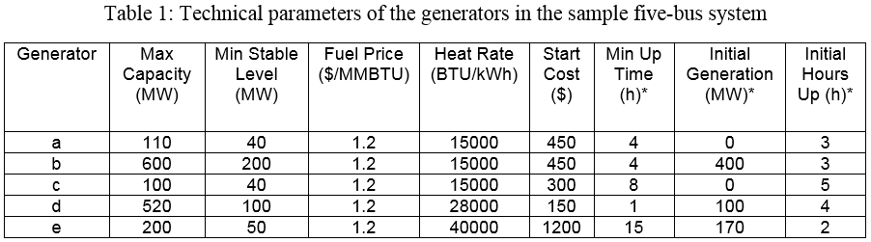
*Max Capacity (MW): represent the maximum generating capacity of each generator.
*Min Stable Level (MW): represent the minimum stable generation level of each generator. This minimum level is enforced when the generator is turned on.
*Min Up Time (hours): represent the minimum number of hours the unit must be 'on' in any commitment cycle.
*Initial Generation: represent is the generator megawatt load at the start of the first period of the simulation.
*Initial Hours Up (hours): Hours the unit has been up for at time zero.

Slide 5
Gen_a
Node
Node 1
Generator
Line_12
Line_15
Gen_b
Inflexible load
Node 2
Node 5
Line_14
Inflexible load
Line_45
Line_23
Node 3
Node 4
Gen_d
Gen_e
Gen_c
Inflexible scenario

Slide 6
Gen_a
Node
Node 1
Generator
Line_12
Line_15
Gen_b
Electrolyzer
Node 2
Node 5
Electrolyzer
Line_14
Line_45
Line_23
Pump storage
Node 3
Node 4
Gen_d
Gen_e
Gen_c
Flexible scenario

Slide 7
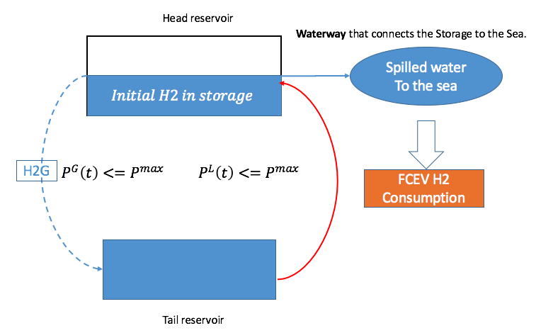
As is shown in the red curve(H1G), it indicates the water is pumped from the tail reservoir to the head reservoir by consuming the electricity. This process is similar with the hydrogen generation of electrolyzer by consuming the electricity.
Once the water is spilled to the sea from the head reservoir, the water volume in the head reservoir will decrease. Similarly, filling the FCEV hydrogen tank at hydrogen station, will decrease the hydrogen storage.
As to the dotted blue curve(H2G), it represents the water flows from the head reservoir to the tail reservoir, which is a electricity generation process.
In this case, we just consider the process of the hydrogen generating, and neglect the electricity generating process by using the hydrogen. So, only the H1G process is considered.
Optional
disable now
H1G

Slide 8
Simulation result
Generation cost (1000$)
Shutdown Cost ($)
The generation cost of BAU is the lowest. After adding the inflexible load, the total generation cost increase significantly. In the “inflexible” case, the generation cost increases because the existing generators have to produce more energy and at the same time since the increased load cannot be shifted (different from the flexible case). However, when the extra load is able to be controlled (flexible scenario), the total generation cost decrease effectively.
The uncontrolled load results in the highest shutdown cost. The result shows that flexibility from hydrogen system can effectively reduce the generator shutdown cost.

Slide 9
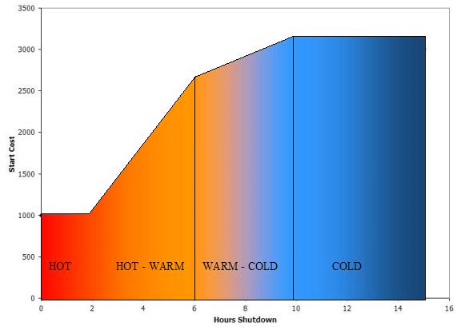
Start & shutdown cost
'hot' for up to two hours after being shutdown and costs $1000 to start inside the two hours;
'warm' for a further four hours (i.e. up to six hours after being shutdown) and costs $2500 to start at the six hour point;
'cold' after it has cooled for a further four hours (i.e. 10 hours in total) and costs $3000 to start at the 10 hour point.

Slide 10
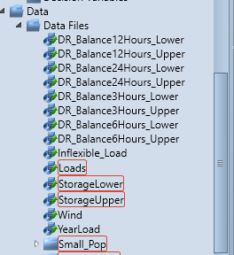
Questions:
In the next plan, will we create 1 region or several regions?
2. How to find the average price of the region? Is the electricity price vary at different nodes, lines? (average cost per kWh)
3. What does the red blank mean?
4. Conversion between the water and the hydrogen
5. Plexos usage:
Cannot run a normal model
Cannot import the data file from the relevant directory

